Slide 1

Corporations & Foundations (CF)

Slide 2


Good morning!!
Why don’t oysters give to charity?
Because they’re shellfish.
Notes:
Sanjana

Slide 3

Thank you Chapters!
Chapters play a very important role in raising funds and awareness for Room to Read. Thank you for everything you do to enhance our efforts around Corporation and Foundation partnerships!
SPOTLIGHT:
Chapter: Montreal
Company: Gildan
Result: US$85K grant confirmed for Bangladesh, upcoming conversations for additional project funding, and great potential to take this partnership even further!
Notes:
Sanjana
Want to share a recent success story that came through an introduction through chapters. You help us succeed and we’ve achieved great things together!

Slide 4
Agenda
Introductions
Pop Quiz
2017 Corporate and Foundation Strategy
Strategy implementation through website redesign
Chapter engagement in CF pipeline
Key Resources
Questions/Discussion
Notes:
Sanjana – review agenda and tell them to feel free to ask questions throughout the presentation. We also will have time at the end.

Slide 5

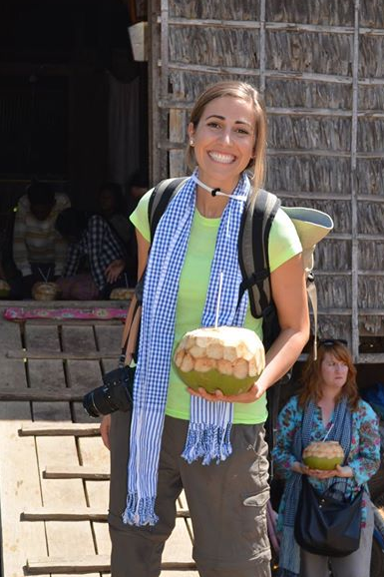
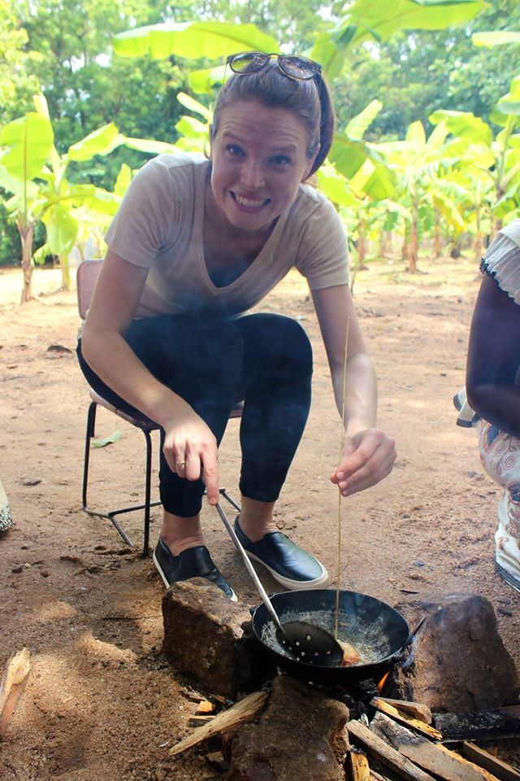
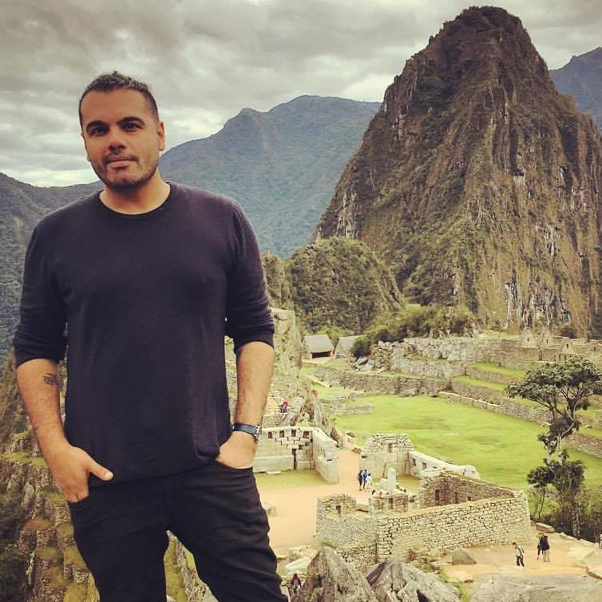
Meet the GBD-CF Team!
Sanjana
Sarah
Susan
Asif
Notes:
All to share a fun fact!
Sanjana – introduce team.
Sanjana – share how long at RtR, what she focuses on
Sanjana to introduce Asif - based in NY, handles east coast relationships
Sarah – share how long at RtR, what she focuses on
Susan– share how long at RtR, what she focuses on

Slide 6
Pop Quiz!
Gifts from Corporations and Foundations account for _____% of Room to Read’s funding:
20-30%
30-40%
70-75%
Notes:
Sanjana
Sanjana to ask everyone to put up their fingers with a 1 2 or 3. Those who are correct will get candy.

Slide 7
Our Team’s 2017 Strategy
Room to Read’s 2017 Corporate/Foundations Strategy
Customized stewardship of key CF Donors and prospects
Focus pipeline development on leveraging existing networks
Activate Employee Engagement Fundraising campaigns globally
Global Gifts-in-Kind sourcing
CF Resources and Communications
Notes:
Sanjana
These are the main categories of focus/strategy for our team this year. We see great potential for chapters to contribute to 2 of these in a significant way: pipeline development and GINKI sourcing. We will speak about that in more detail a bit later. But first we wanted to share how portions of this strategy are being operationalized through last year’s re-design of Room to Read’s website.

Slide 8
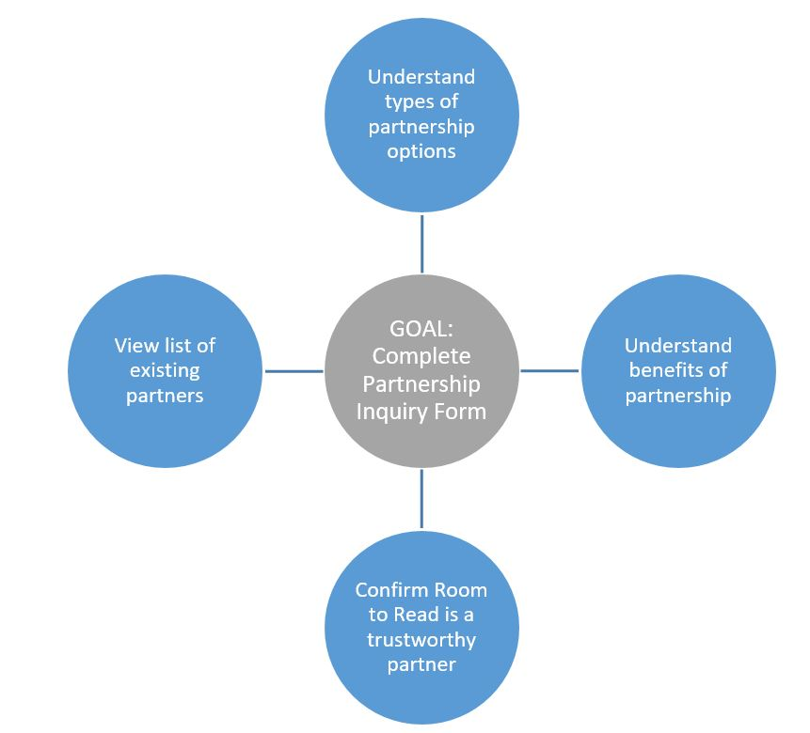
Strategy implementation through website
Notes:
Sarah
Our website was redesigned last year to focus on those the two specific goals Sanjana just mentioned – pipeline and in-kind gift sourcing.
When we went through the redesign process, we started by outlining the information we wanted corporate and foundation partners to find.
We wanted them to understand the types of partnership options (grants, employee engagement cause marketing and GINKI)
Understand the benefits of partnership
Confirm Room to Read is a trustworthy partner
And view existing list of partners, through top donor lists and case studies
The end goal of all of this is for people to be interested in becoming a partner, and filling out a partnership inquiry form! This is how we will be engaging and cultivating new donors.
We’re going to walk you through our section of the website, and then show you the inquiry form and how you can help.

Slide 9
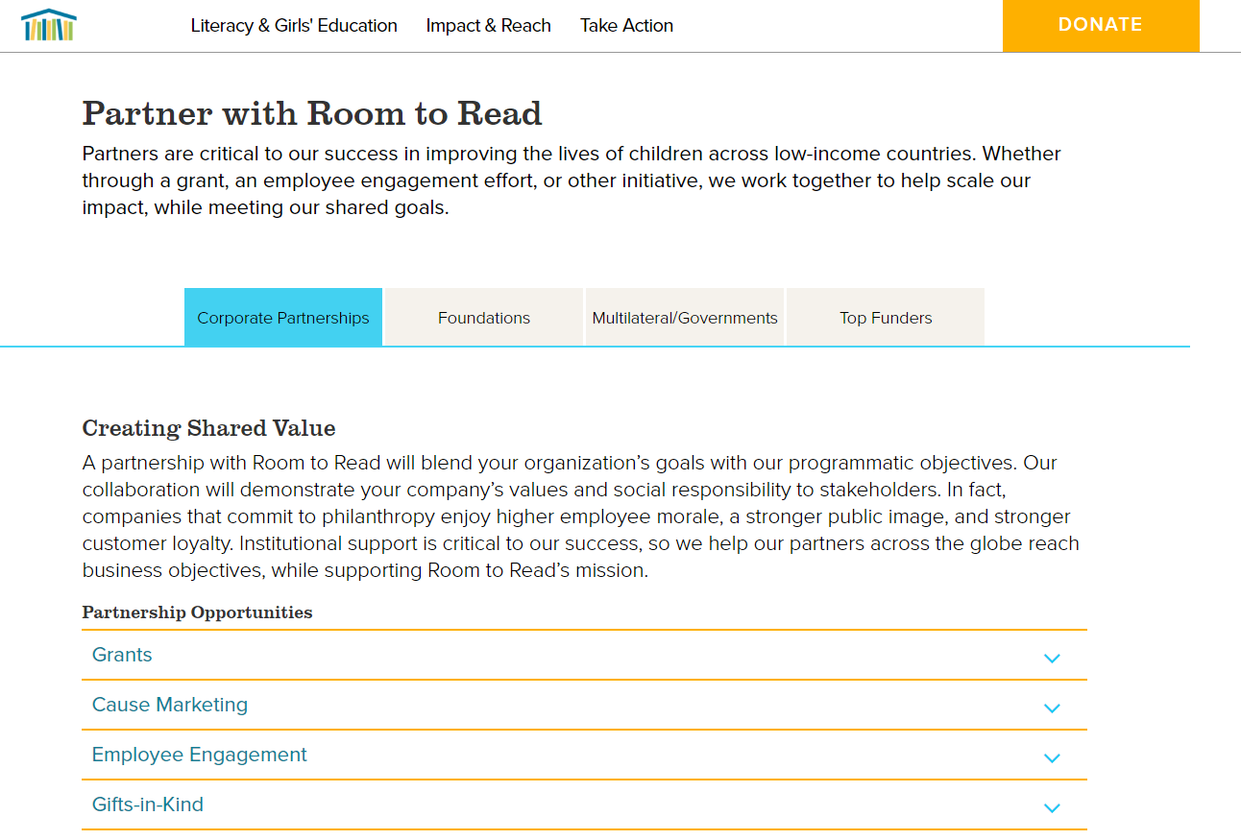
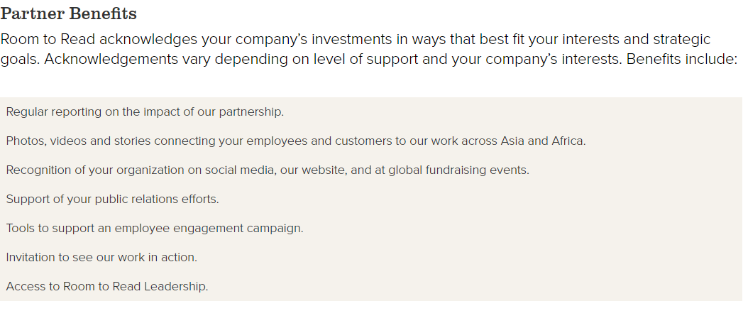
New Partner Section of the Website
Notes:
Susan
https://www.roomtoread.org/partner-with-us/?tab=top%20funders
https://www.roomtoread.org/partner-with-us/partner-case-studies/?tab=grants
Looking to achieve 1-4 with ultimate goal of people completing the partnership inquiry form.

Slide 10
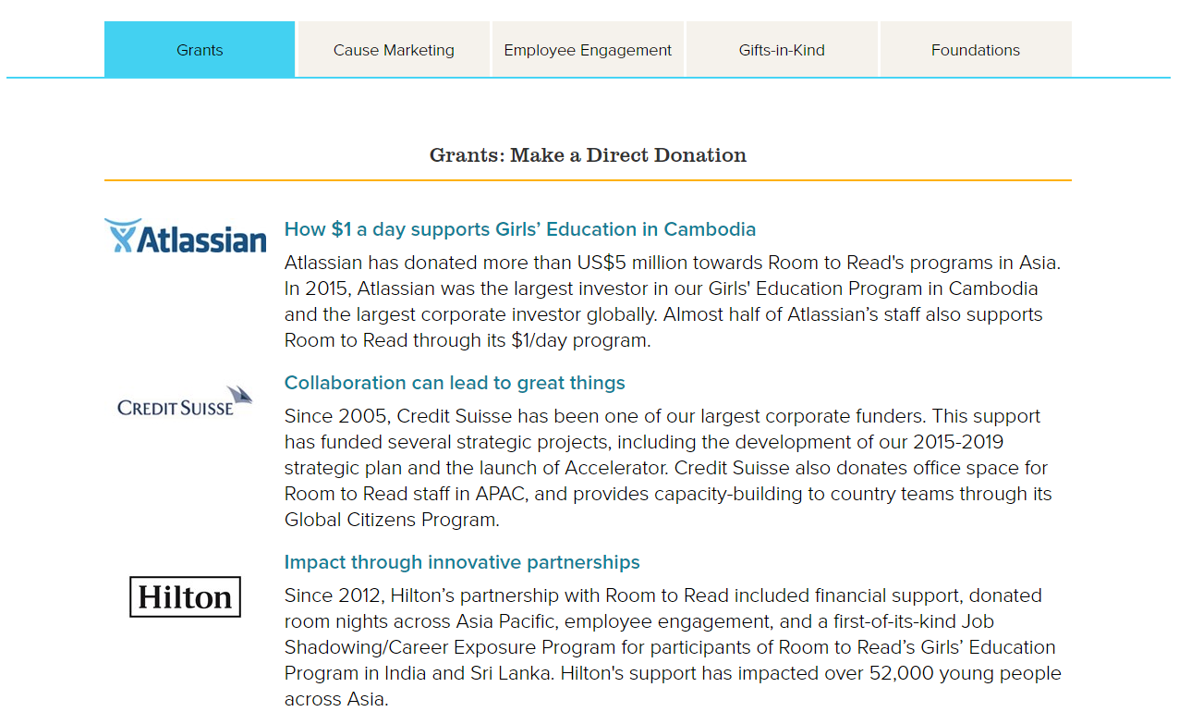
New Partner Section of the Website
Notes:
Susan
Case studies – demonstrate to potential partners how RtR works with companies in a variety of capacities

Slide 11
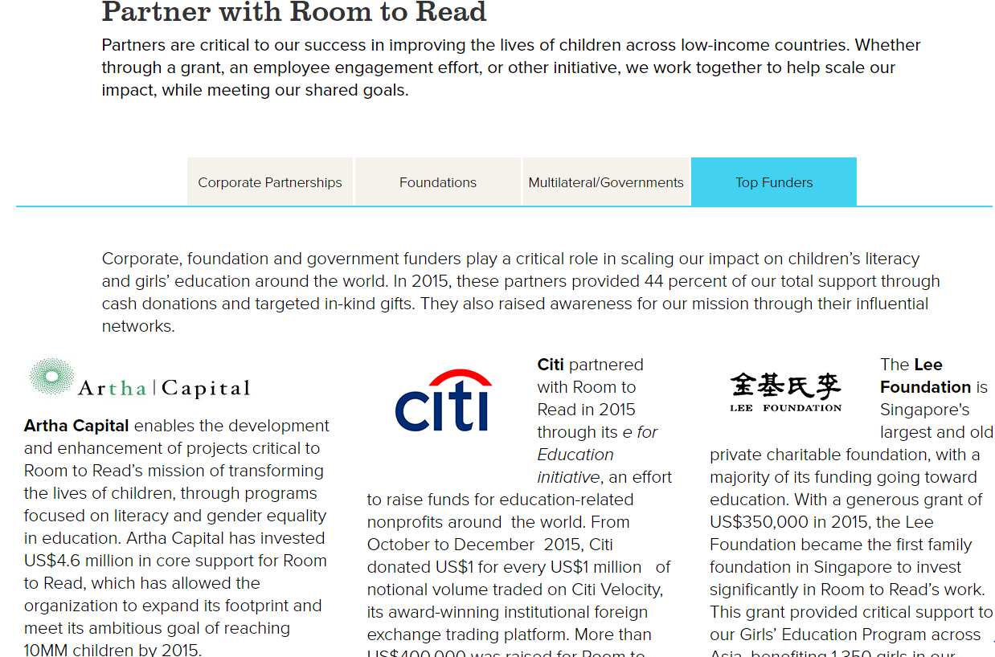
New Partner Section of the Website
Notes:
Susan
Top Funders – This is a great way to see Room to Read’s top donors. It’s a mirror of what we publish in each year’s Annual Report, which includes all Corporate and Foundation donors giving over $50,000 in the previous year.
Looking to achieve 1-4 with ultimate goal of people completing the partnership inquiry form.

Slide 12
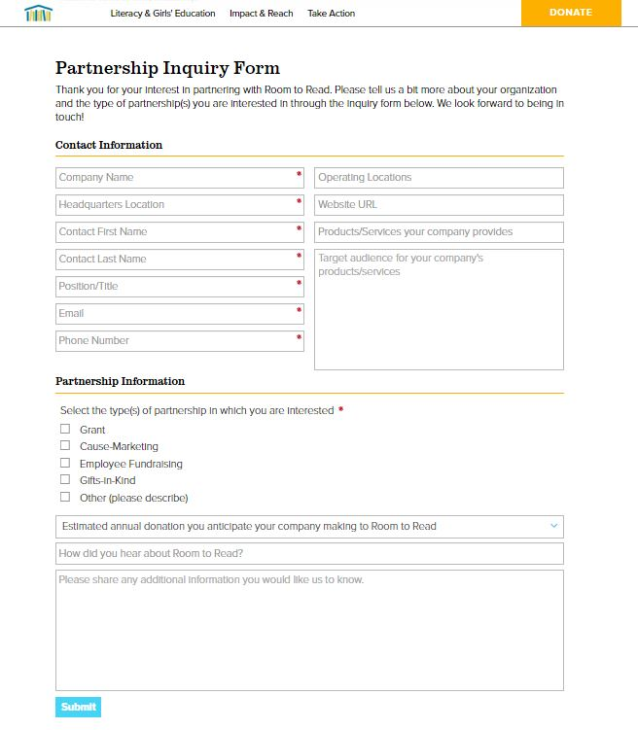
Partnership Inquiry Form
This is a new way for us to streamline incoming inquiries and Chapter leads
Notes:
Susan

Slide 13
Partnership Inquiry Form - Chapters
When should you fill out the partnership inquiry form?
To inquire about a potential lead if you are not sure if Room to Read has/has had a relationship with company or foundation
  Ex) Salesforce and Fossil
To pass along a lead at a company or foundation with a national/global reach (i.e. they can give beyond local events)
To pass along a lead at a potential publisher who could donate new children’s books (see resource slide for in-kind guidelines)
To pass along a lead at a tech company with software that may be useful (ex: Salesforce, Cisco Webex, Tableau) or hardware, tablets, laptops, etc.
Notes:
Sarah
Salesforce – local event budget (yes, move forward but give history)
Fossil – declined moving forward

Slide 14
Tracking Partnership Inquiry Form Leads
In order to track where leads are coming from and give Chapters credit for new donors, enter your Chapter name in the “How did you hear about Room to Read?” field of the form!
Enter your Chapter name here!
Notes:
Sarah
How did you hear about Room to Read? (manual entry) Tracking where these are coming from re: chapters

Slide 15
Partnership Inquiry Form Vetting Process
Inquiry Form is submitted (by company or Chapter)
If lead is a good fit, CF team alerts the proper RM based on company’s market
Initial conversations with donor begin. If lead came from a Chapter, gifts resulting from partnership will be credited on Chapter’s thermometer!
CF Team is alerted that a new form has been submitted
CF Team reviews form to see if the lead meets minimum partnership requirements
If lead is not a good fit, CF team sends a polite email to decline partnership to Chapter or Company
RM to update Chapter contact on partnership status as appropriate
Notes:
Sarah
Walk through the process of the forms

Slide 16
When to use Partnership Inquiry Form
Example 1: Company was a sponsor at Chapter event
Company X sponsored or provided an auction prize at your Chapter event
Through conversations, you think they are a good fit and are interested/willing in pursuing a partnership beyond your city
What do you do?
  Fill out Partnership Inquiry form on the website
  Use YOUR personal contact information so that we can get in touch and make sure we have proper background and a personal introduction
  For “Position/title” insert “Chapter Member”
Notes:
Sarah

Slide 17
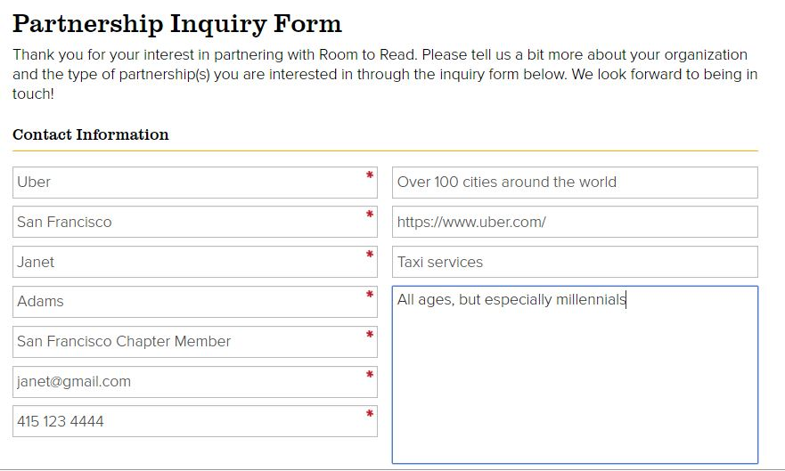
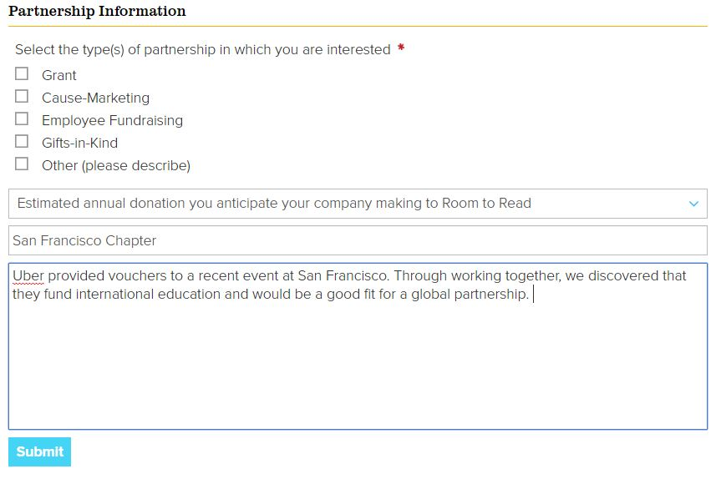
Sample Form
Your name here!
Your Chapter here!
Notes/further information here
Notes:
Sarah

Slide 18
When to use Partnership Inquiry Form
Example 2: You have CSR contact within your company to introduce to Room to Read
What do you do?
  Fill out Partnership Inquiry form on the website
  Use YOUR personal contact information so that we can get in touch and make sure we have proper background and a personal introduction
  For “Position/title” insert “Chapter Member”
Notes:
Sarah

Slide 19
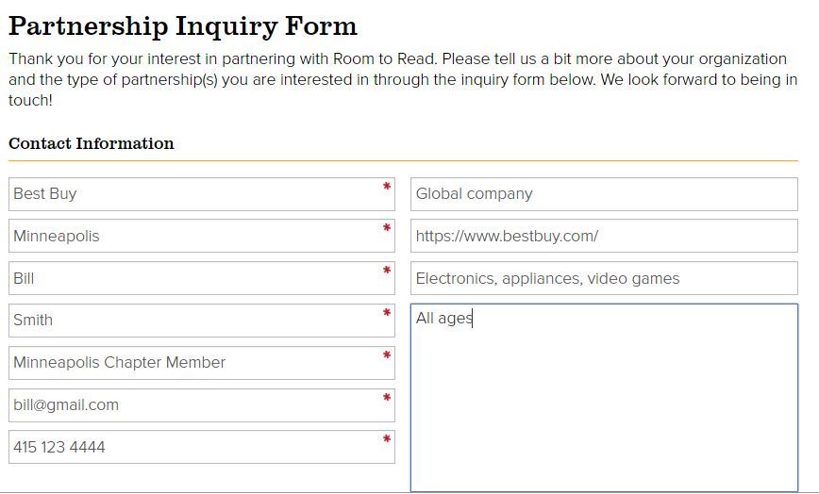
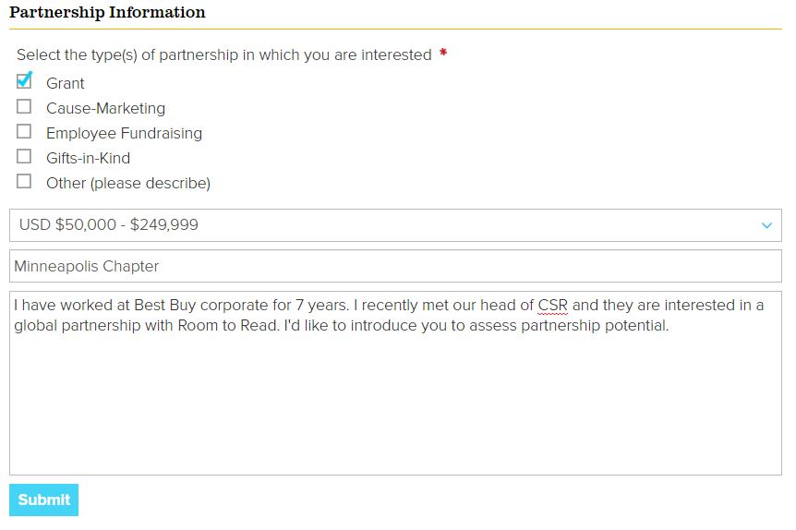
Sample Form
Your name here!
Your Chapter here!
Notes/further information here
Notes:
Sarah

Slide 20
When to use Partnership Inquiry Form
Example 3: Chapter member meets new point of contact at a company who is very interested in partnering with Room to Read, but has no established relationship
Rather than starting a relationship at the local level, you believe this company has greater/global potential
What do you do?
  Encourage your point of contact to fill out the Partnership Inquiry form on the website
  They will use their own contact information, and Room to Read will be in touch directly
  Advise them to note your Chapter in the “How did you hear about Room to Read” question
Notes:
Sarah

Slide 21
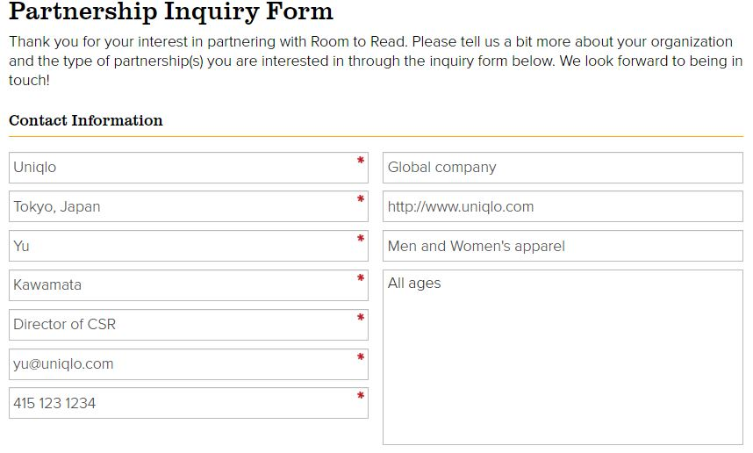
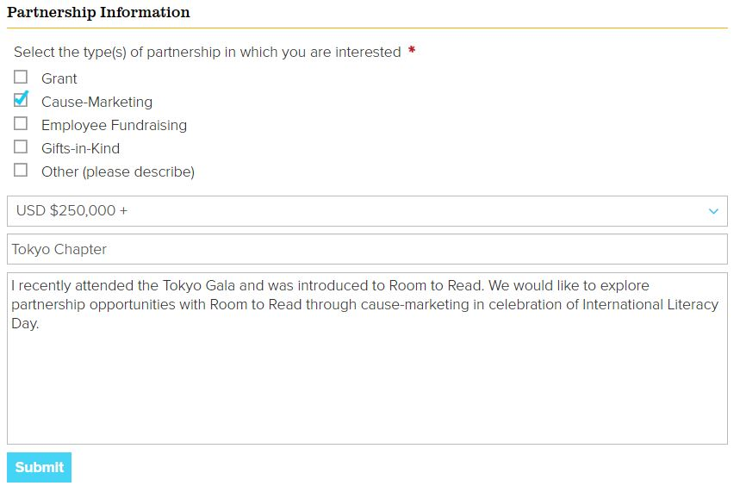
Sample Form
Their name and contact info here!
Your Chapter here!
Notes:
Sarah

Slide 22
Benefits of this process
Why this new process?
It allows us to:
Centralize and streamline the process for new leads
Respond to opportunities instantly
Ensure chapters are credited for new corporate donors
Grow our database efficiently
Notes:
Sarah

Slide 23
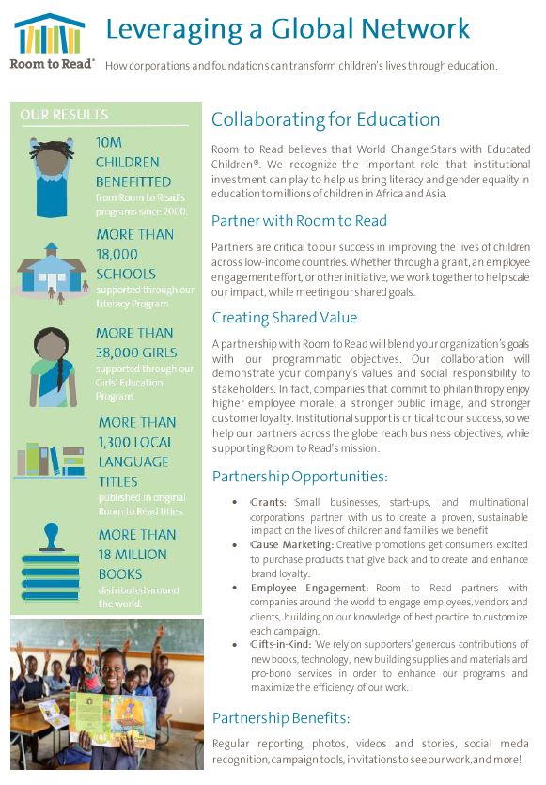
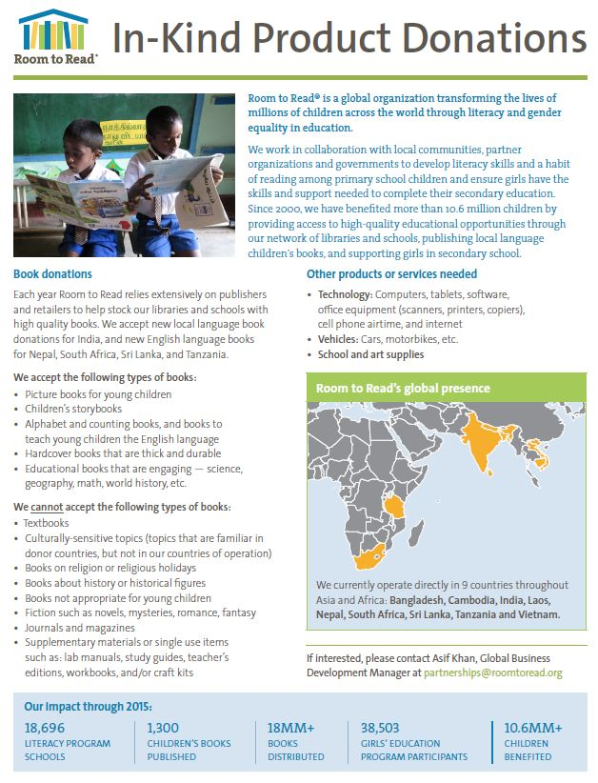
Links to Key Resources
CF Resources in the Chapter Hub
Follow the Corporate fundraising steps
Updated CF Brochure is a great overview document to share with leads
The GINKI two-pager outlines in-kind gifts we can/can’t accept
Visit the Partner Section of the website
Talk about existing partners and partnership models through our Case Studies page
For the latest and greatest in CF partners, check out the Top Partners tab
Notes:
Sarah

Slide 24

Questions?

Slide 25

Thanks!

